Slide 1
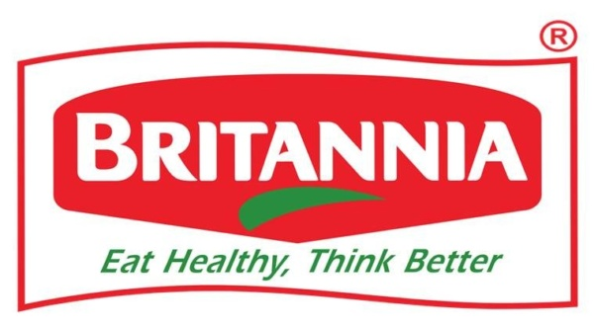


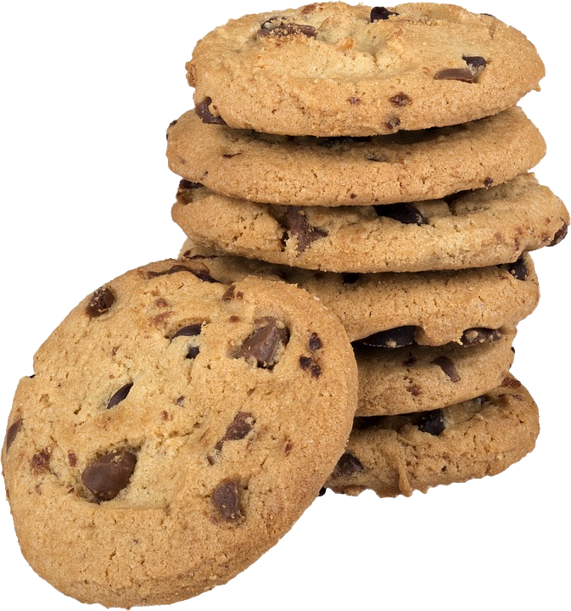
This Photo by Unknown Author is licensed under CC BY-NC

Slide 2
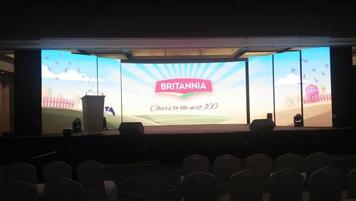

InaugUral of britannia
Britannia started in the year of 1892 with a mere investment of Rs. 295 in the city of Kolkata, which has now reached an enterprise value of more than 89 thousand crores INR. Britannia is one of the most trusted brands in the common Indian household. The company’s major product portfolio includes biscuits, breads, cakes and dairy products. Some of its products that rule the markets include Good Day, Tiger, Marie Gold etc.

Slide 3


Company’s organiZation
Britannia with a large presence in the differentiated biscuit offerings is expected to benefit. Additionally, the company has been reducing dependence on the biscuits segment by expanding its dairy portfolio, and launching products in the wellness segment. These initiatives will benefit the company's margins favorably in the long run, and increase its "tastiness" as an investment. Wadia group is the owner of the company.
Britannia’s profit more than doubled during the lockdown and sales were the best in at least five quarters
Britannia posted a 117% jump in its consolidated net profit to ₹545.7 crore for the first quarter ended June 30.
The total revenue was up by 26% to ₹3,384 crore compared to the same period last year.
The company stated in its quarterly filings that it “implemented some innovative ways of working in sales, supply chain & other support functions” during the pandemic, which supported the growth.
Britannia company, which earns 70% of its revenue from biscuits segment, would gradually increase the pie of non-biscuit category by going into new products, said the Managing Director Varun Berry.
Nusil Wadia

Slide 4


Inventory turnover
As we can see from the adjacent graph, Britannia shows a stable Inventory Turnover over the past few years.
Whereas, Jubilant Foodworks firstly showed tremendous growth, but later saw a sharp dip. Britannia is expected to maintain a consistent Inventory Turnover.

Slide 5

Working capital turnover
T
As shown here, Jubilant Foodworks shows a large range of Working Capital Turnover, whereas Britannia and Nestle shows a stable Working Capital Turnover. Britannia also showed a slight growth in 2021.

Slide 6
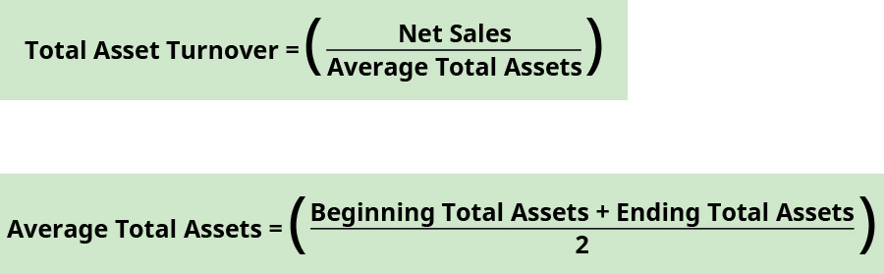
Total assets turnover
In the following graph, we can see that both Britannia and Jubilant Foodworks saw a major dip in their Total Assets Turnover whereas Nestle saw a significant growth.
However, this is due to the general slowdown all over the country and world due to the Covid pandemic.

Slide 7
Debt-to-equity RATIO
As seen here, all the three companies saw a sharp rise in the year 2020. But still, Britannia proved to be most consistent in these years as well due to its trust basis in the market.

Slide 8


Long term predictions
Financial growth
The share price of the company has shown a consistent growth in the past 5 years.
Britannia was amongst those companies which recovered instantly from the slowdown. The lockdown didn’t much affect the share price of the company.
We set the target price of Britannia at Rs. 3850 at the end of Fiscal Year 2021.
The company seems to show a stable growth in this decade.
If has shown a consistent resilience even during the covid period when most other companies saw a sharp plunge in their growth.
During the past few years, the company has shown a consistent growth in its revenue, and is expected to do so in the coming years.
Share price

Slide 9
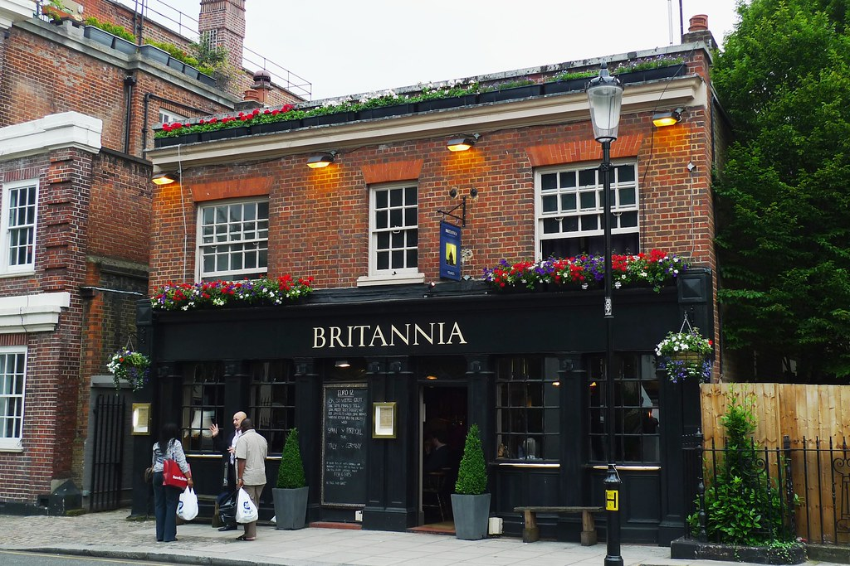



Overseas expanse
Return on equity
As of now, Britannia has a business in 5 continents.
The company recently opened a plant in Gujarat which is only for export purposes.
Britannia is also looking forward to open new plants overseas, and is mainly looking towards Africa.
Britannia has shown a consistent stable growth in the financial markets.
The company is expected to grow at an average rate of 30% over the next 5 years and at an average rate of about 35% over the next 5 years after that.

Slide 10





Thank you!
swatik20@iitk.ac.in
prakhar20@iitk.ac.in
Representing ppt by swati and prakhar

